Slide 1

The Efficacy of the Covid-19 Vaccine
Andrew Jordan and Jahedur Rahman

Slide 2
Introduction
Rampant spread of Covid-19 (Coronavirus) starting in the beginning of 2020.
Covid-19 vaccination was created and distributed in 2021
Many countries tracked and recorded data of Covid-19 including:
Hospitalizations, testing, and vaccinations
Notes:
Early in the year of 2020 marked as the beginning of the rampant spread of Covid-19, also known as
the coronavirus, which is a deadly virus that required a global response to fight against
The most important thing among the world's focus was to create a vaccine against this virus
The vaccination was created and distributed in 2021
There were and still are many countries that track and record Covid-19 data.
Some of this data include hospitalizations, testing, and vaccinations

Slide 3
Problem statement
There has been many different controversies regarding the vaccination.
One is that the vaccination is not effective against Covid-19, and that it can cause more issues to a person’s health.
Our hypothesis is that the Covid-19 vaccine is effective against the virus, and that it has caused a reduction in the number of people becoming infected.
Notes:
People around the world have many controversies and doubts about the vaccination
There are many that believe the vaccination has no effectiveness against the virus and that it
can cause more issues to a person's health
With this project we aim to prove that the Covid-19 vaccine is effective against the virus,
and that it has caused a reduction in the number of people becoming infected.

Slide 4
The Data
The COVID-19 dataset is a collection of the COVID-19 data maintained by Our World in Data.
Data includes:
Confirmed cases and deaths: this comes from the COVID-19 Data Repository by the Center for Systems Science and Engineering (CSSE) at Johns Hopkins University (JHU)
Hospitalizations and intensive care unit (ICU) admissions
Testing for COVID-19
Vaccinations against COVID-19
Other variables
194031 rows × 67 columns
Notes:
The dataset we have analyzed is a collection of the COVID-19 data maintained by Our World in Data.
This data includes Confirmed cases and deaths which comes from the COVID-19 Data Repository by the
Center for Systems Science and Engineering at Johns Hopkins University
It also includes Hospitalizations and intensive care unit admissions
Testing for COVID-19
Vaccinations against COVID-19
and many Other variables
In total the dataset consists of 194031 rows and 67 columns

Slide 5
Data Preparation
Initial dataframe had 194,031 rows of data
Filter out rows of data to include United States as location
Changed date column type to datetime64[ns]
Initial dataframe had 67 columns of data
Subset 24 columns
Final dataset has 875 rows x 24 columns
Notes:
Since the dataset is so large, we had to do some preparation and cleansing to the data before starting the analyses
We filtered out the rows of the data to only include data that had United States set as the location
We had to change the column type of the date column to datetime64
In addition, we had to remove 43 column of data after some deliberation
Our final dataset consists of 875 rows and 24 columns

Slide 6
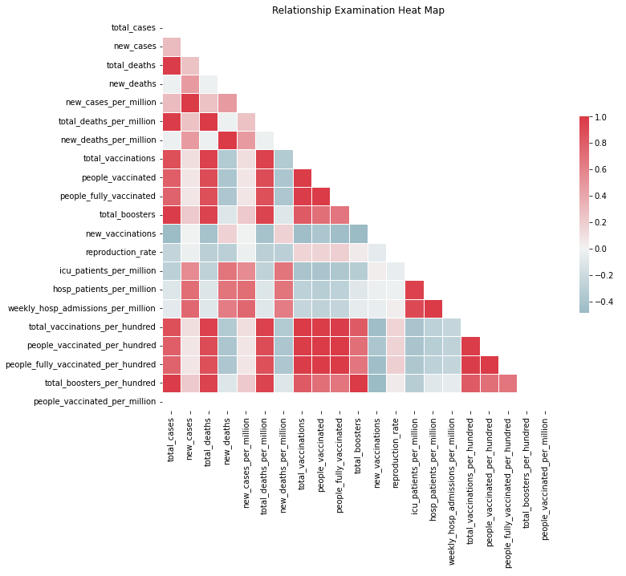
Analysis
Figure 1
A heatmap was used for the initial examination of correlation within the subset data
Several potentially significant correlations were found
Notes:
Examining the data curated into a subset was an essential next step, one that would guide our decision-making process when choosing a target variable.
The heatmap indicated potentially significant relationships between several features, so to identify the most significant variables further examination was needed.

Slide 7
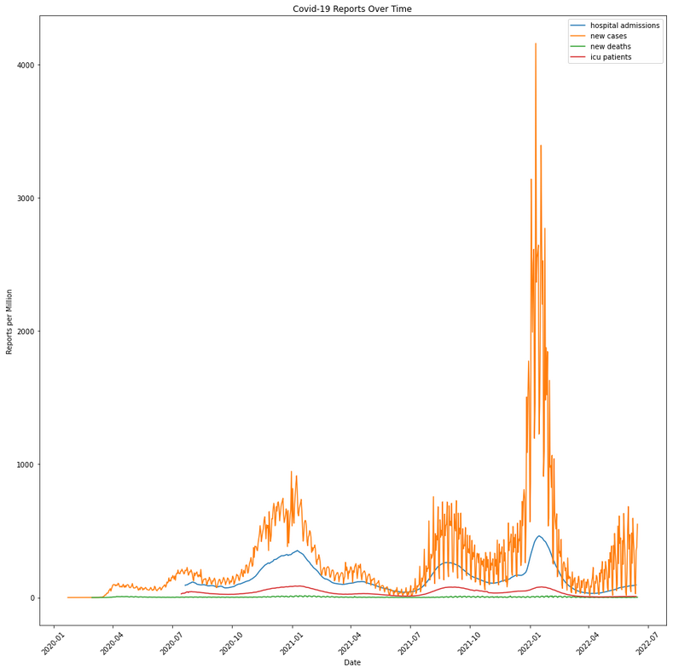
Analysis
Figure 2
Line graph comparing features:
Weekly Hospital Admissions per million
New Cases
New Deaths
Weekly ICU Patients
Variant Infection Spikes (approximate dates):
Delta Variant (August-September 2021)
Omicron Variant (December 2021)
Vaccine rollout dates:
March 2021 (Initial Vaccination)
October 2021 (First Boosters)
April 2022 (Second Booster)
Notes:
Further analysis was performed by examining the changes in several of the most significant features over time: Weekly Hospital Admissions per million, New Cases, New Deaths, and Weekly ICU Patients
In combination with the identification of potential correlation through the heatmap, this figure provided excellent insight.
The first things noticed were the large spikes present in both New Cases and Hospital Admissions. When compared against data from the CDC Covid-19 Timeline, the spikes in new cases and hospital admissions directly correspond with the spread of the dominant Covid-19 variants: the Delta variant in mid 2021 and the Omicron variant in late 2021-early 2022.
The second significant observation made was regarding the dips seen in the new case and hospital admission features. Using the United States Department of Health and Human Services Covid-19 Vaccine timeline, we were able to confirm that the dips in new cases and hospital admissions each closely followed vaccine and booster rollouts.
All together, these observations drove our decision to use Weekly Hospital Admissions per Million as our target variable. While new cases also closely followed the same trend as hospital admissions, those vaccinated that were covid-19 positive may never have known or reported the information. As Weekly Hospital Admissions can more accurately represent the number of serious Covid-19 cases it was chosen for use as the target variable over New Cases.

Slide 8
Data Preparation
The Linear Regression model chosen was not showing reliable results
As the data was not conducive to linear evaluation of the relationships, a new model type was needed.
The newly chosen model was a Random Forest Classifier
To properly utilize the model a new variable entitled ‘change’ was created, the code for which is seen below
Figure 3
Notes:
After choosing the target variable we moved forward with a Linear Regression model. Unfortunately, the data and relationships being utilized were not fit for linear examination.
Altering the project to use a Random Forest Classifier model was our next step. To best identify changes in weekly hospital admission rates a new variable was created entitled ‘change’ that had a 0 for no increase seen over the previous week’s hospital admissions or a 1 for an increase seen over the previous week’s hospital admissions, the code for which can be seen in figure 3.
Using a 70/30 split, the subset data was split into training and test data with the new ‘change’ variable as the target.

Slide 9
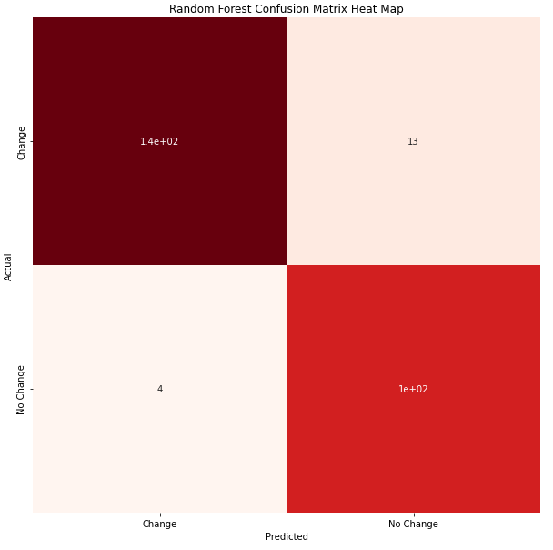
Results
Figure 4
As hypothesized, the results show a significant relationship between vaccination and hospital admission rates
The Random Forest Classifier showed excellent results with a ≈95% accuracy score
As shown in the Confusion Matrix Heat Map a total of only 17 of the values utilized were misclassified
Notes:
In line with the initial examination of relationships and our hypothesis, the Random Forest Classifier model results indicate a significant negative correlation between vaccination and hospital admissions. As vaccination rates rise weekly hospital admissions drop.
Using the accuracy score metric, the Random Forest Classifier model showed an accuracy score of approximately 95%.
To further examine the accuracy of the results, a Confusion Matrix Heat Map was created. The accuracy of the model was again evident as there were only 4 instances in which change was predicted and did not occur, and only 13 instances in which change occurred but no change was predicted.

Slide 10
Conclusion
Without the ability to reliably track exactly which Covid-19 variant every reported individual had our recommendation is reliant solely upon our model’s results
As our results show, there is a significant relationship between vaccination and lower rates of hospitalization
This relationship would indicate that getting a Covid-19 vaccination makes one significantly less likely to suffer from a serious infection causing hospitalization
Our recommendation is for anyone approved to do so to get their Covid-19 vaccination and booster shots as available
Notes:
Though ideally the data could be separated by variant type, the real-world logistics of tracking exactly what type of Covid-19 variant each individual has had is unrealistic. Without that any recommendation is reliant upon the results shown by our model, which again indicates a strong relationship between vaccination and lower rate of hospitalization.
This relationship that our results show indicates that being vaccinated correlates with a lower chance of hospitalization from all Covid-19 variants seen thus far.
Our conclusion is in line with the medical community’s recommendation: anyone able to safely get their Covid-19 vaccine and booster shots should do so as they are made available

Slide 11
References
CDC Museum COVID-19 Timeline. (2022, January 5). Centers for Disease Control and Prevention. https://www.cdc.gov/museum/timeline/covid19.html
Assistant Secretary for Public Affairs (ASPA). (2022, August 4). COVID-19 Vaccines. HHS.Gov. https://www.hhs.gov/coronavirus/covid-19-vaccines/index.html
Dataset: https://github.com/owid/covid-19-data/tree/master/public/data

Slide 12
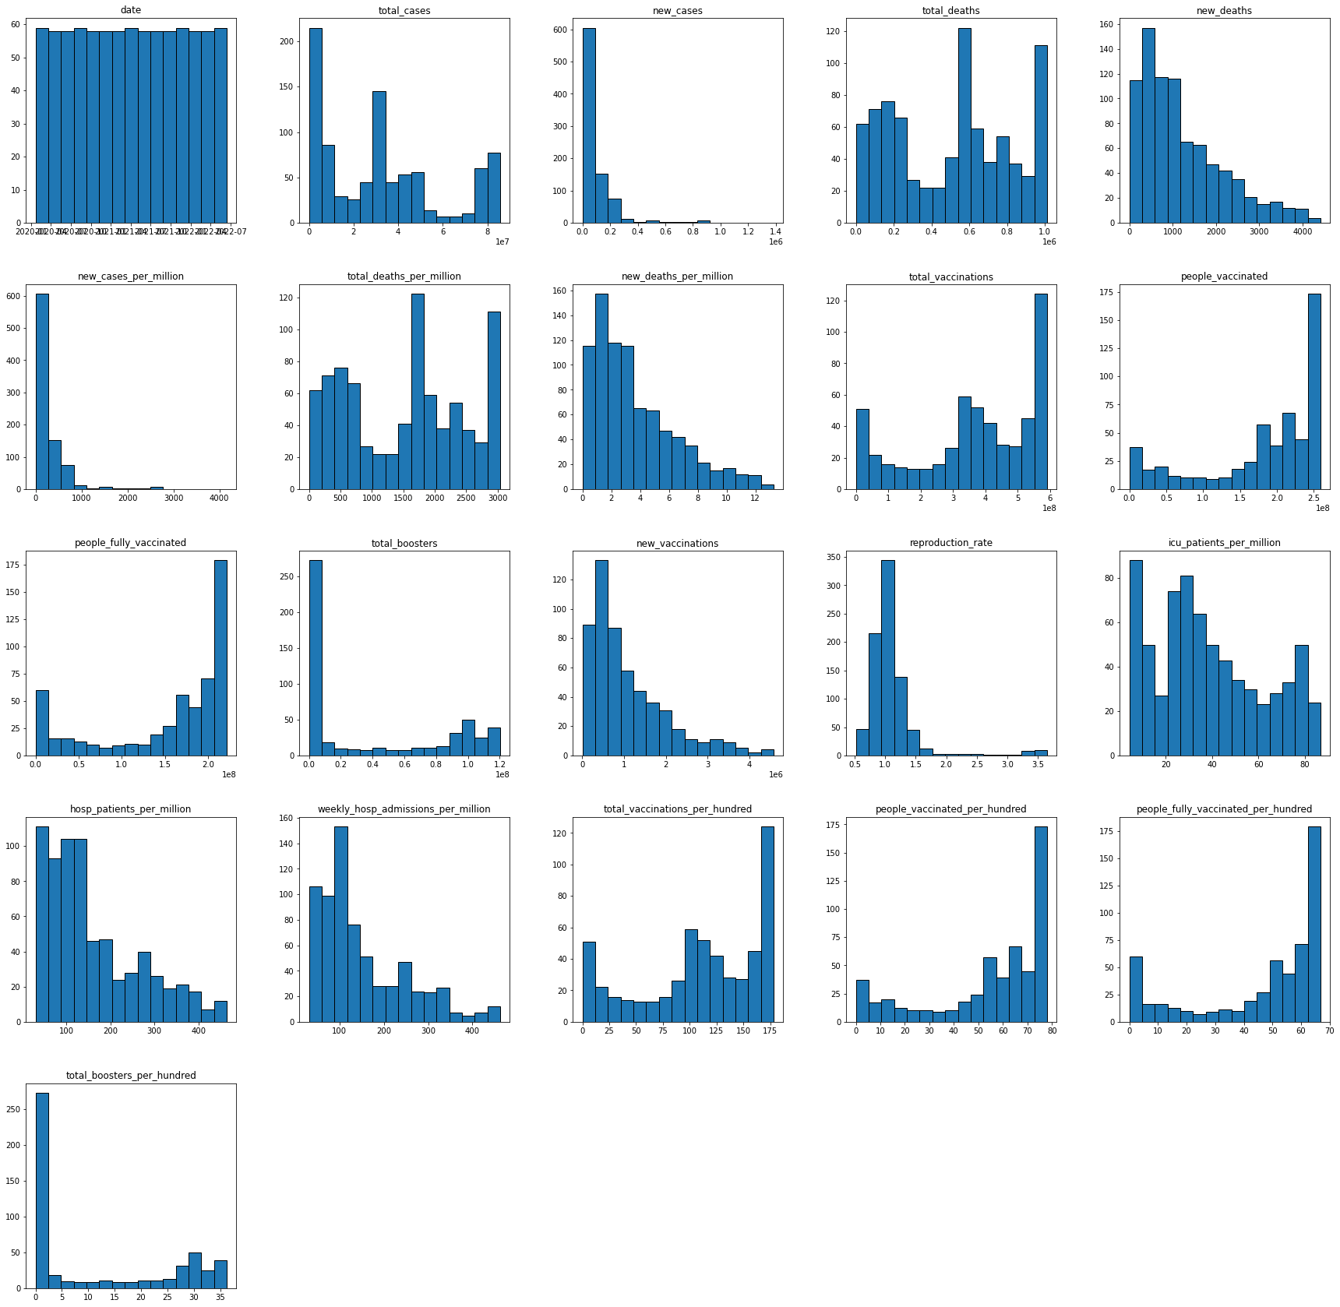
Analysis
Histogram of each column

